Slide 1


Digital Electronics Fundamentals 201.1
-Logic States
-Truth Tables
-Logic Gates
-Inverters
-AND/NAND Gates
-OR/NOR Gates
-XOR/XNOR Gates

Slide 2
1 Logic States
By "digital electronics" we mean circuits in which there are only two(usually) states possible at any point, a transistor that can either be in saturation or be non conducting. We usually choose to talk about voltages rather than currents, calling a level HIGH or LOW. The two states can represent any of a variety of "bits" (binary digits) of information, such as the following:
one bit of a number
whether a switch is opened or closed
whether a signal is present or absent
whether some analog level is above or below some preset limit
whether or not some event has happened
whether or not some action should be taken
etc.
The HIGH and LOW states represent the TRUE and FALSE states of Boolean logic.
**Excerpt taken from: The Art of Electronics by Paul Horowitz

Slide 3
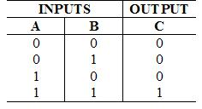
2 Truth Tables
A truth table is a mathematical table used in Boolean algebra to compute the functional values of logical expressions on each of their possible variations.
Practically, a truth table is composed of one column for each input variable (for example, A and B), and one final column for all of the possible results of the logical operation that the table is meant to represent (for example, A XOR B). Each row of the truth table therefore contains one possible configuration of the input variables (for instance, A=true B=false), and the result of the operation for those values.
**Excerpt taken from: Wikipedia article on Truth Tables.

Slide 4
3 Logic Gates
A logic gate is a physical device implementing a Boolean function, that is, it performs a logical operation on one or more logic inputs and produces a single logic output.
Logic gates are primarily implemented using diodes or transistors acting as electronic switches, but can also be constructed using electromagnetic relays (relay logic), fluidic logic, pneumatic logic, optics, molecules, or even mechanical elements. With amplification, logic gates can be cascaded in the same way that Boolean functions can be composed, allowing the construction of a physical model of all of Boolean logic, and therefore, all of the algorithms and mathematics that can be described with Boolean logic.
Logic gates can be seen as the primary building blocks of digital electronics.
**Excerpt taken from: Wikipedia article on Logic Gates.

Slide 5
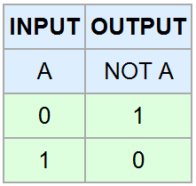
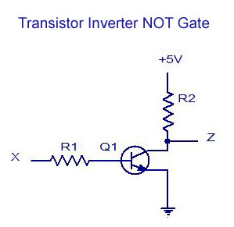
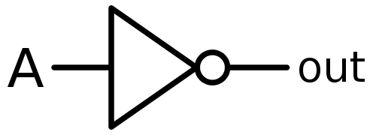
4 Inverters
In digital logic, an inverter or NOT gate is a logic gate which implements logical negation. The truth table is shown below:
**Excerpt taken from: Wikipedia article on Logic Inverters.

Slide 6


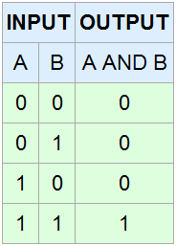
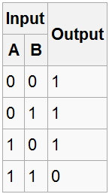
5 AND/NAND Gates
The AND gate is a basic digital logic gate that implements logical conjunction - it behaves according to the truth table below.
A HIGH output (1) results only if both the inputs to the AND gate are HIGH (1). If neither or only one input to the AND gate is HIGH, a LOW output results.
In another sense, the function of AND effectively finds the minimum between two binary digits. Therefore, the output is always 0 except when all the inputs are 1s.
**Excerpt taken from: Wikipedia article on AND Gates & NAND Gates.

Slide 7


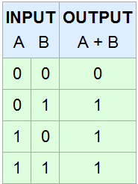
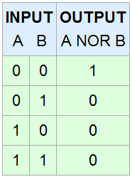
6 OR/NOR Gates
The OR gate is a digital logic gate that implements logical disjunction - it behaves according to the truth table below.
A HIGH output (1) results if one or both the inputs to the gate are HIGH (1). If neither input is HIGH, a LOW output (0) results.
In another sense, the function of OR effectively finds the maximum between two binary digits, just as the complementary AND function finds the minimum.
**Excerpt taken from: Wikipedia article on OR Gates & NOR Gates.

Slide 8


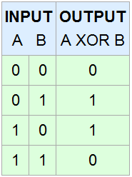
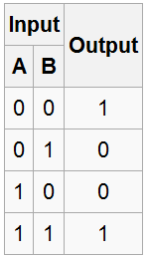
7 XOR/XNOR Gates
The XOR gate is a digital logic gate that implements an exclusive or; that is, a true output (1) results if one, and only one, of the inputs to the gate is true (1).
If both inputs are false (0) or both are true (1), a false output (0) results. Its behavior is summarized in the truth table shown below.
A way to remember XOR is "one or the other but not both". It represents the inequality function, i.e., the output is HIGH (1) if the inputs are not alike otherwise the output is LOW (0).
**Excerpt taken from: Wikipedia article on XOR Gates and XNOR Gates.

